Slide 1
Lab 5: AWS Tutorials
Charlie André & Sufyan Shaikh

Slide 2
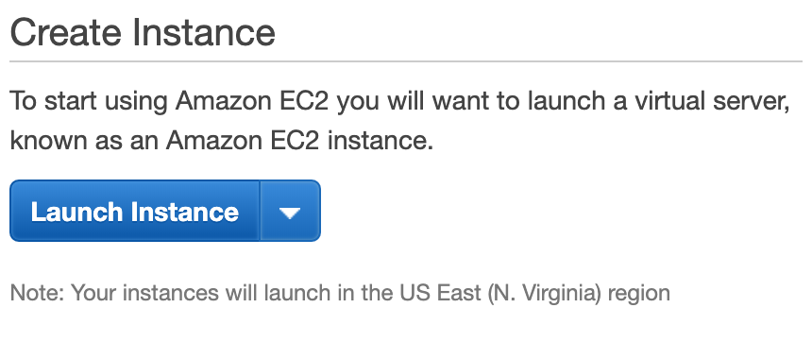
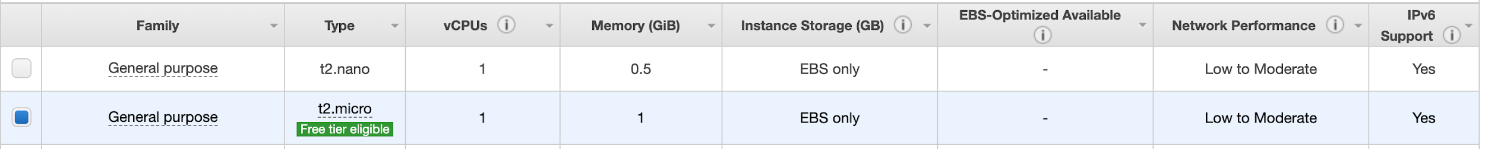
EC2
→ Create the instance by clicking “Launch Instance”
→ Select the Configuration you would like to Run:
→ Select the # of vCPUs and amount of memory, we chose the free tier eligible amount:

Slide 3
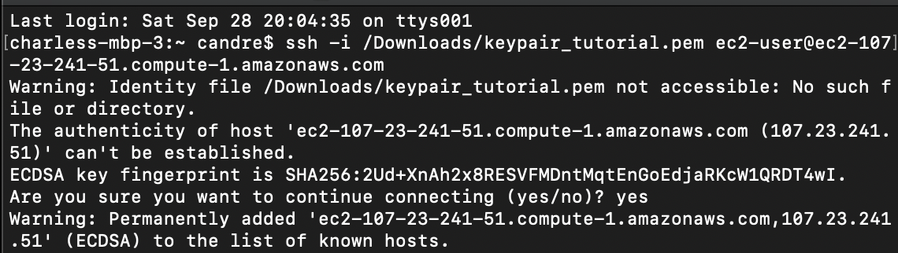
EC2
→ To connect to the system with SSH generate a key pair, set up the execution environment. ssh -i /pathname_where_key_is_located ec2-user@domain

Slide 4
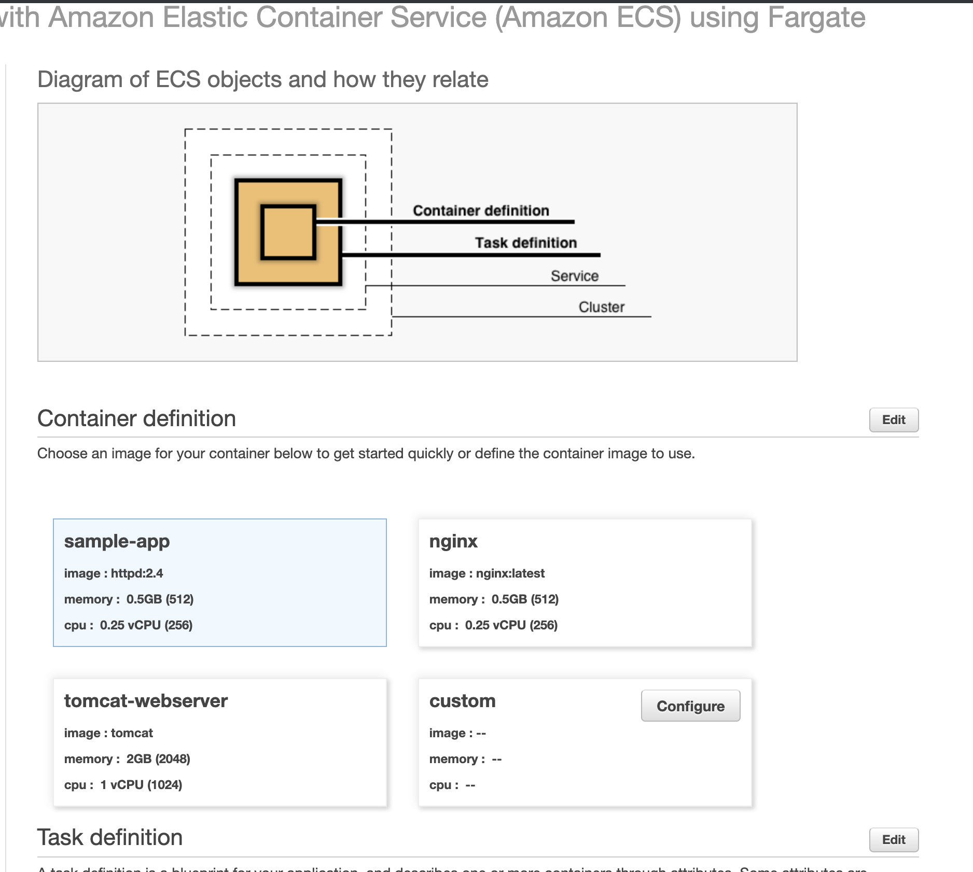
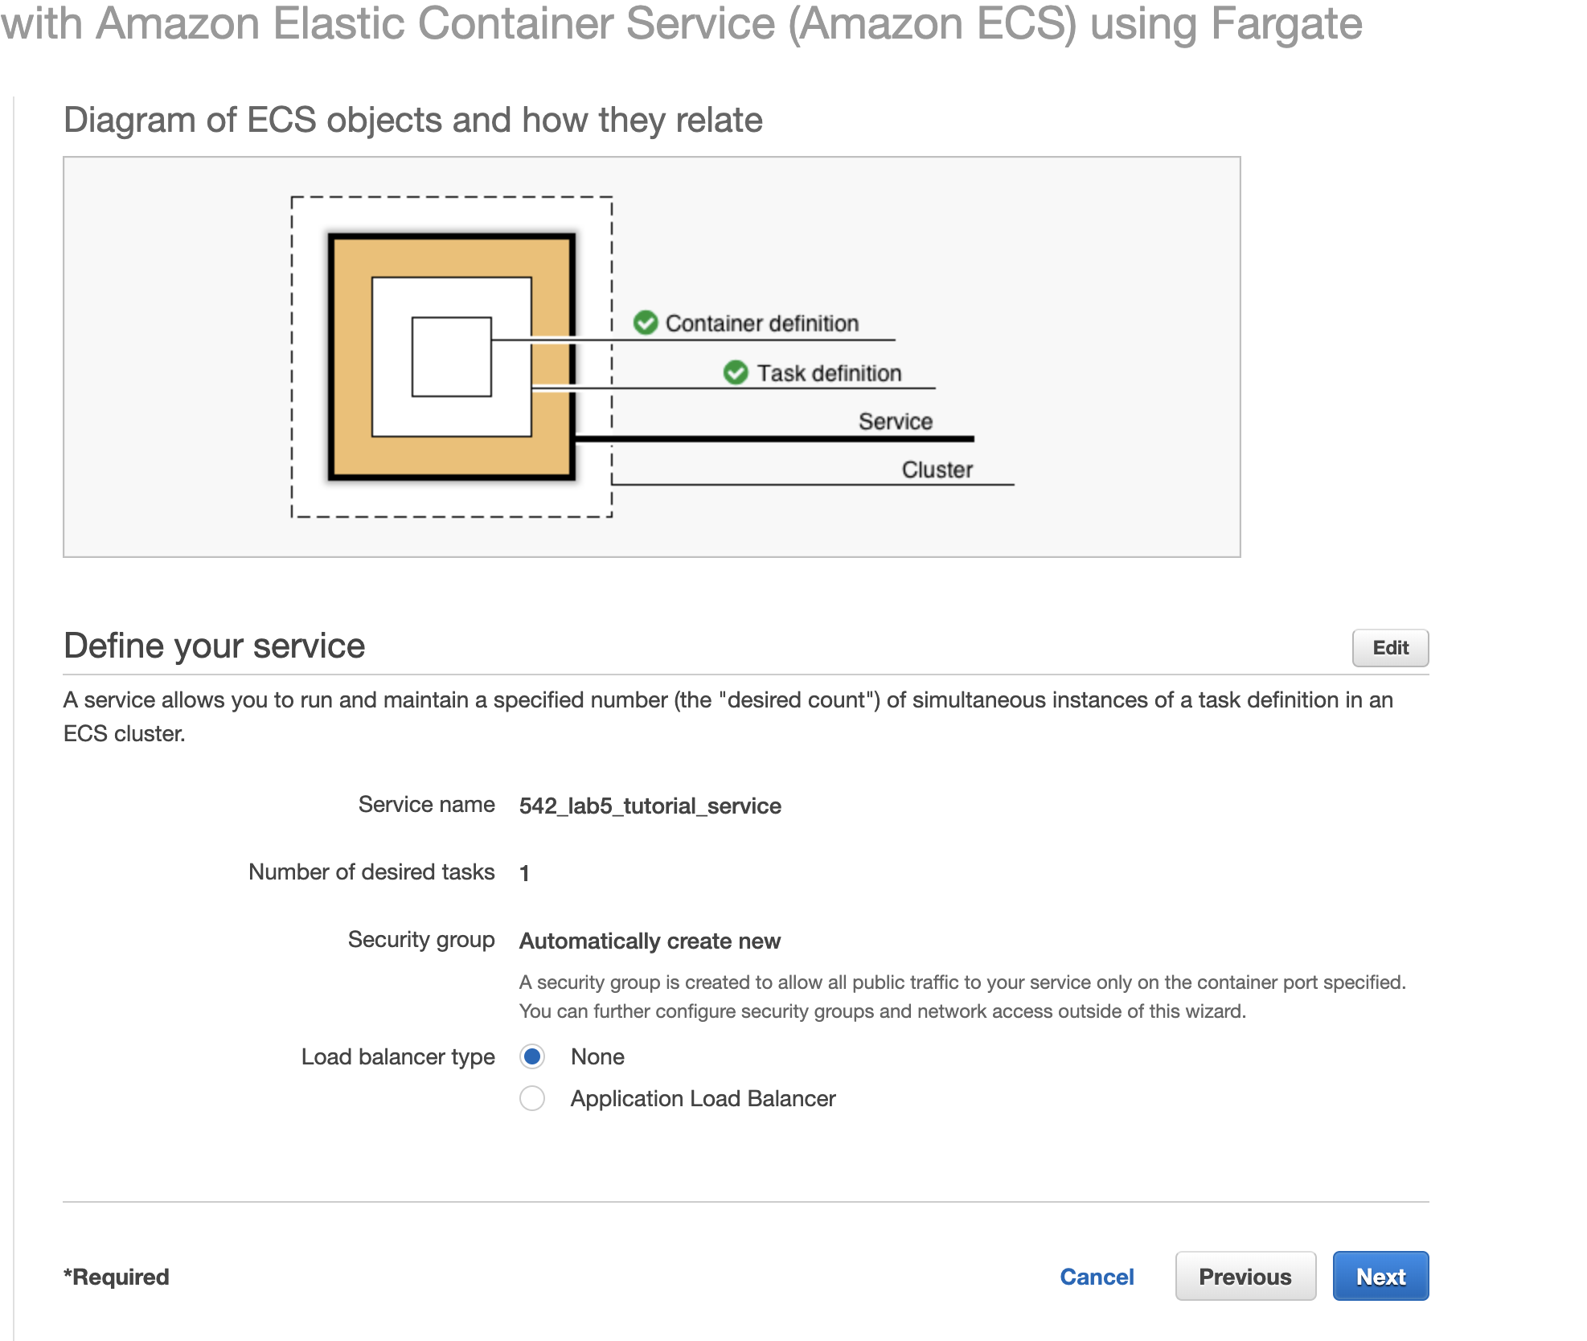
EC2
→ Running a sample container application

Slide 5
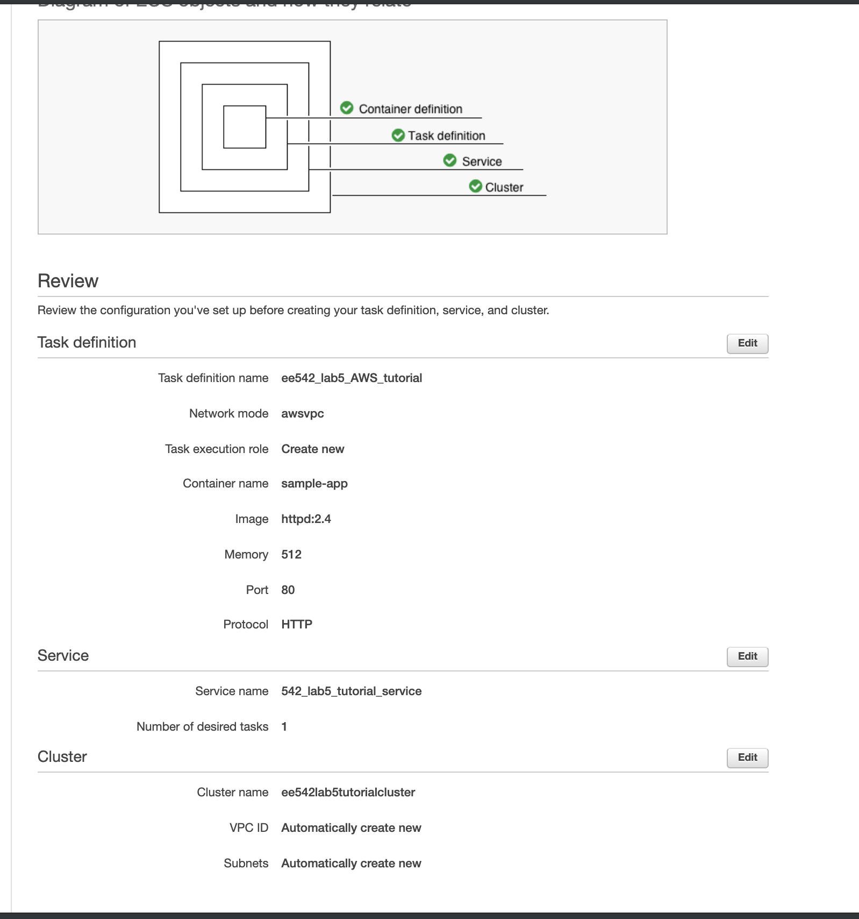
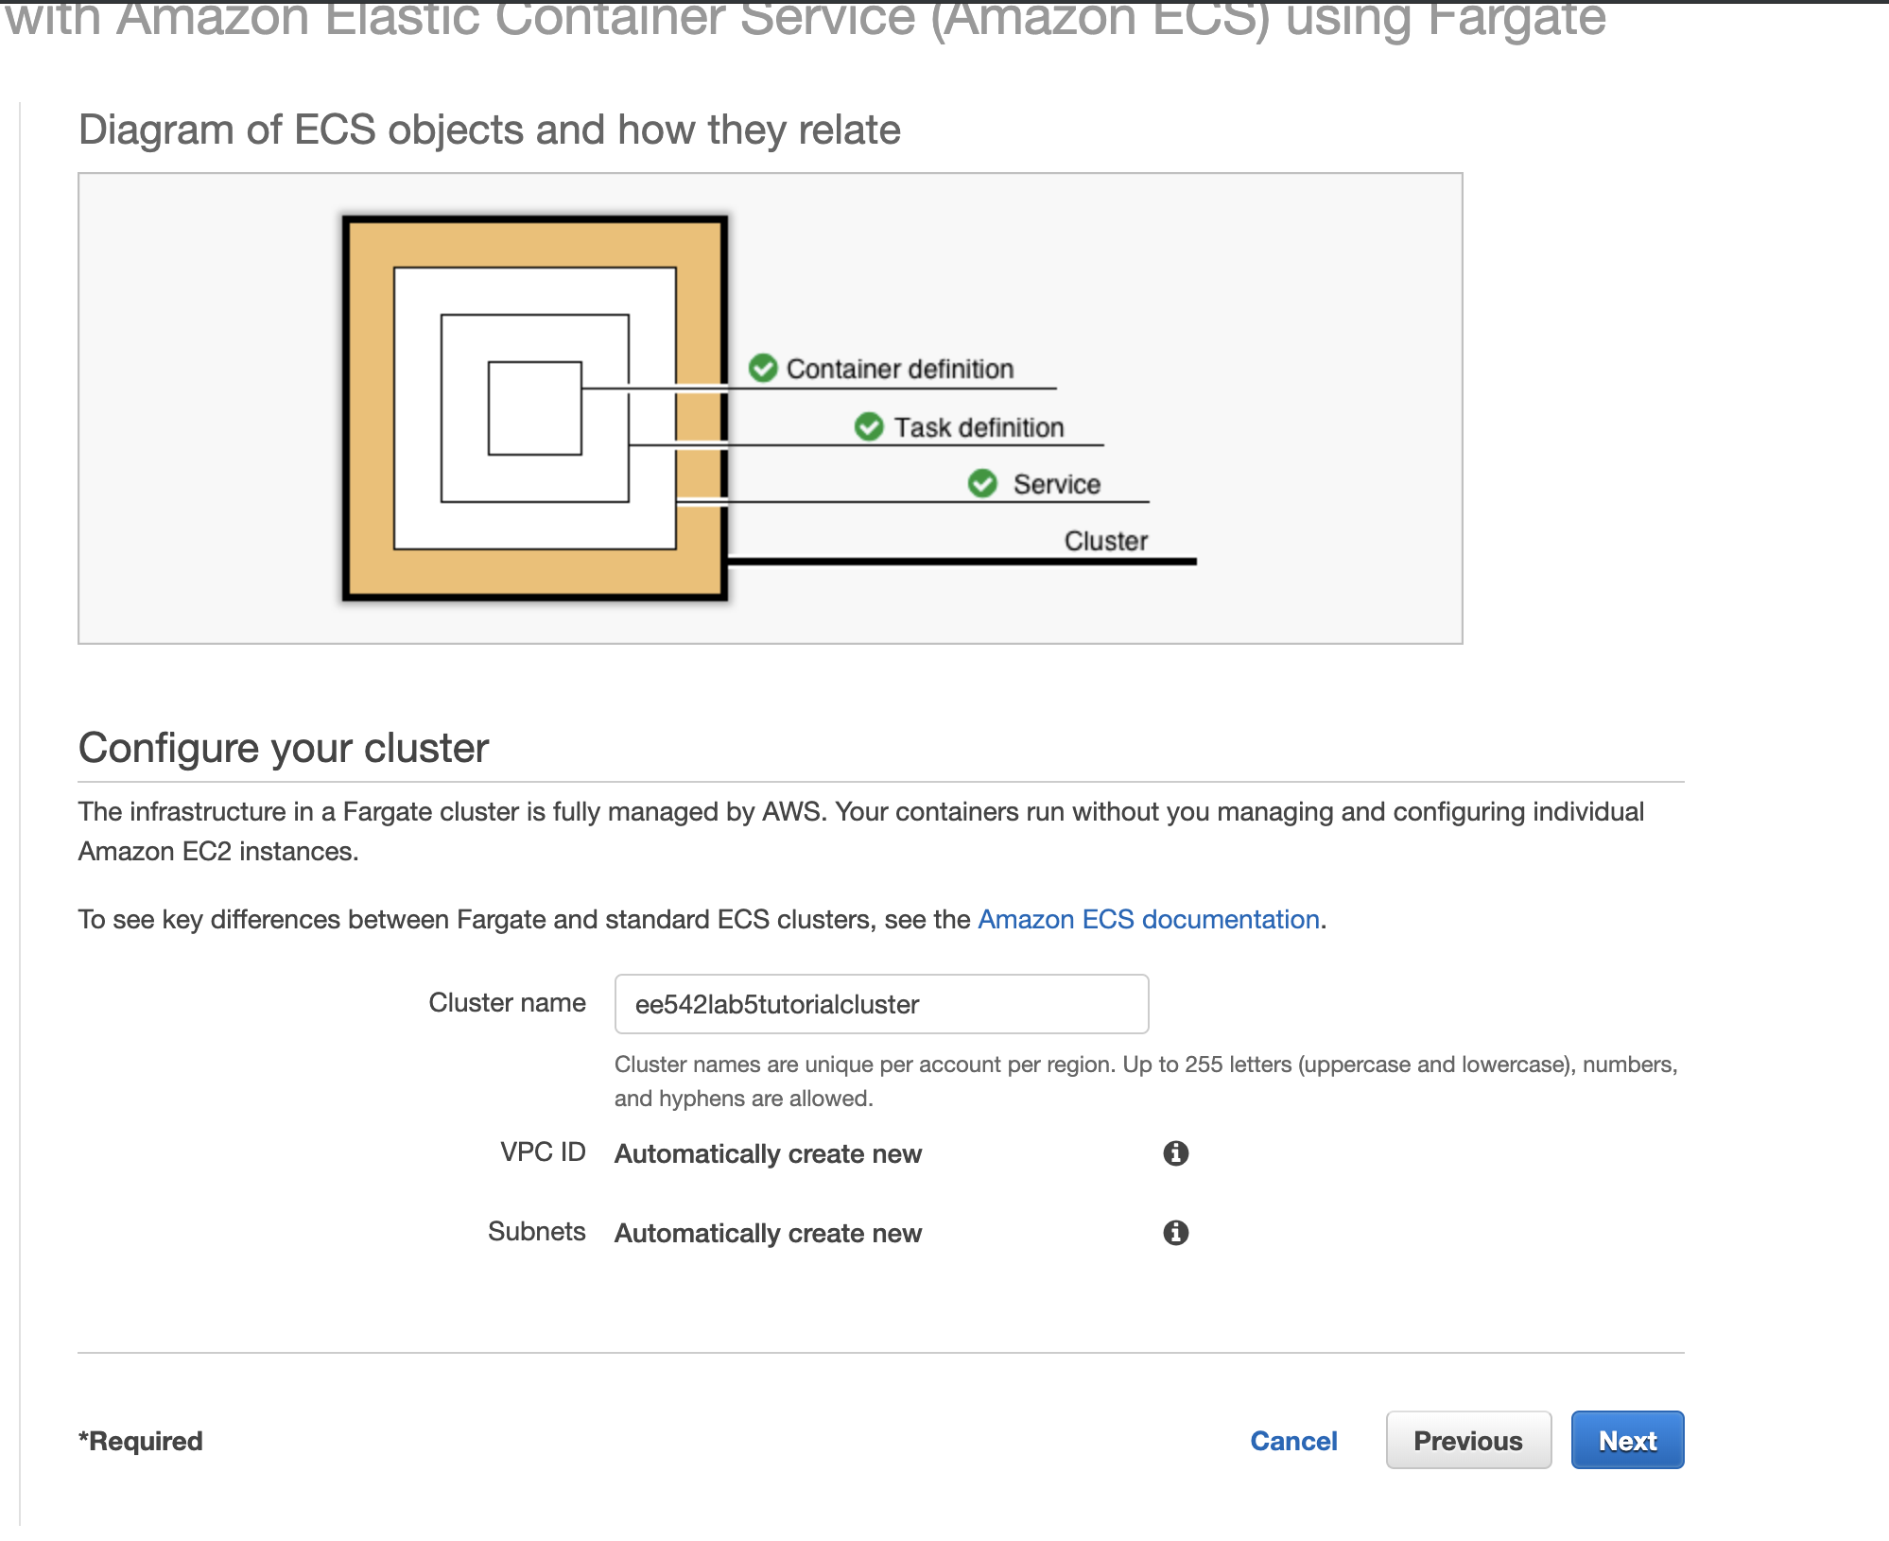

Slide 6
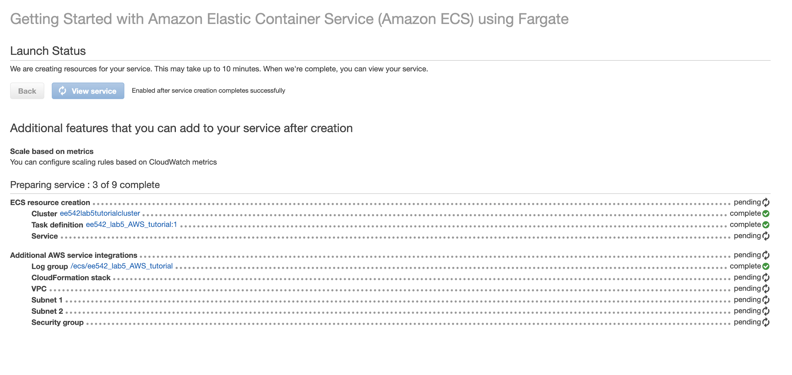
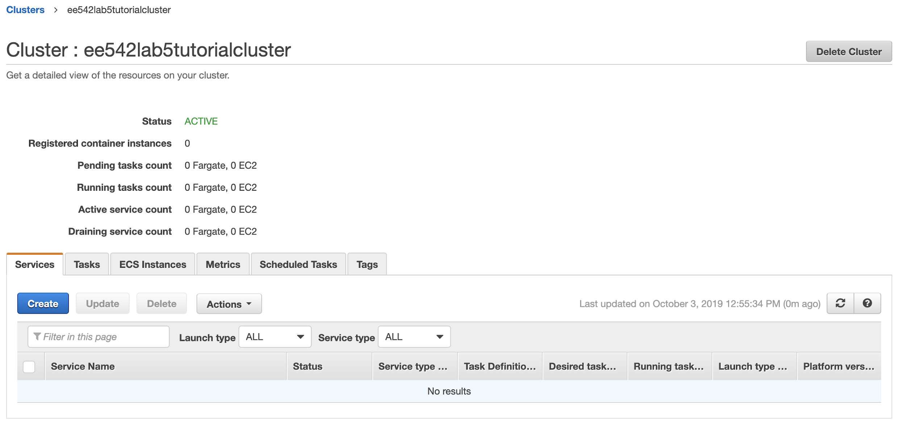

Slide 7
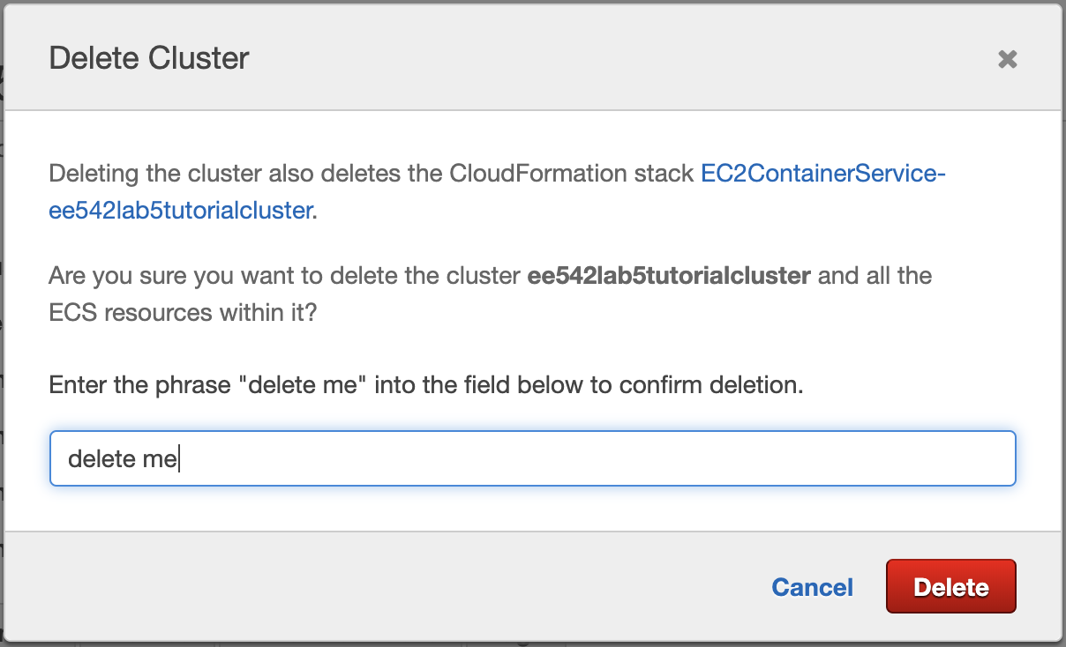
→ Shutdown the container and its host EC2 to avoid additional charges

Slide 8
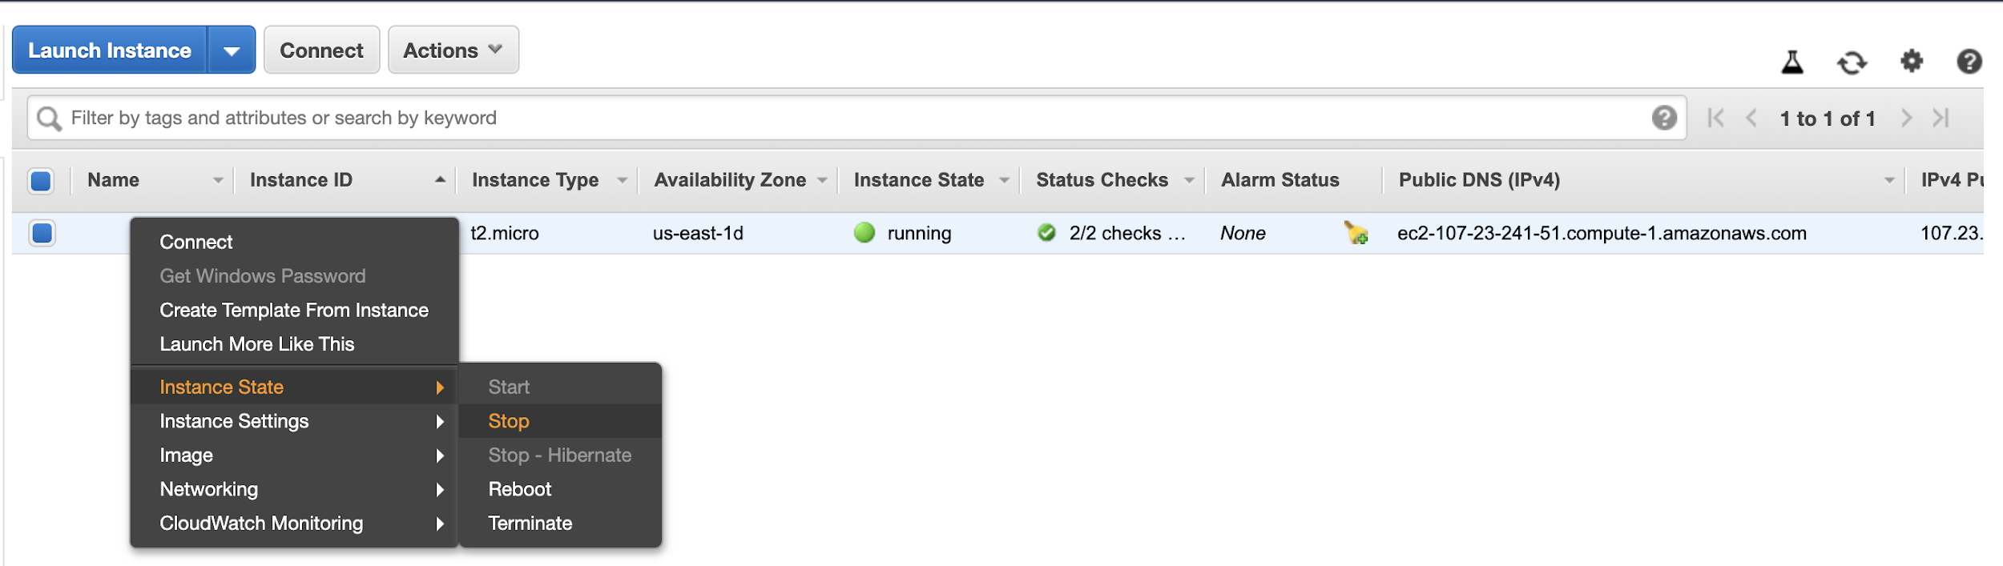
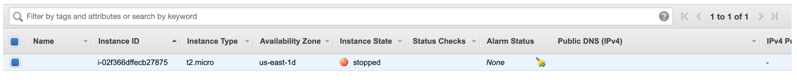
EC2 (cont…)
→ Remember to shutdown the instance after you are done using it as it can continue to bill you.

Slide 9
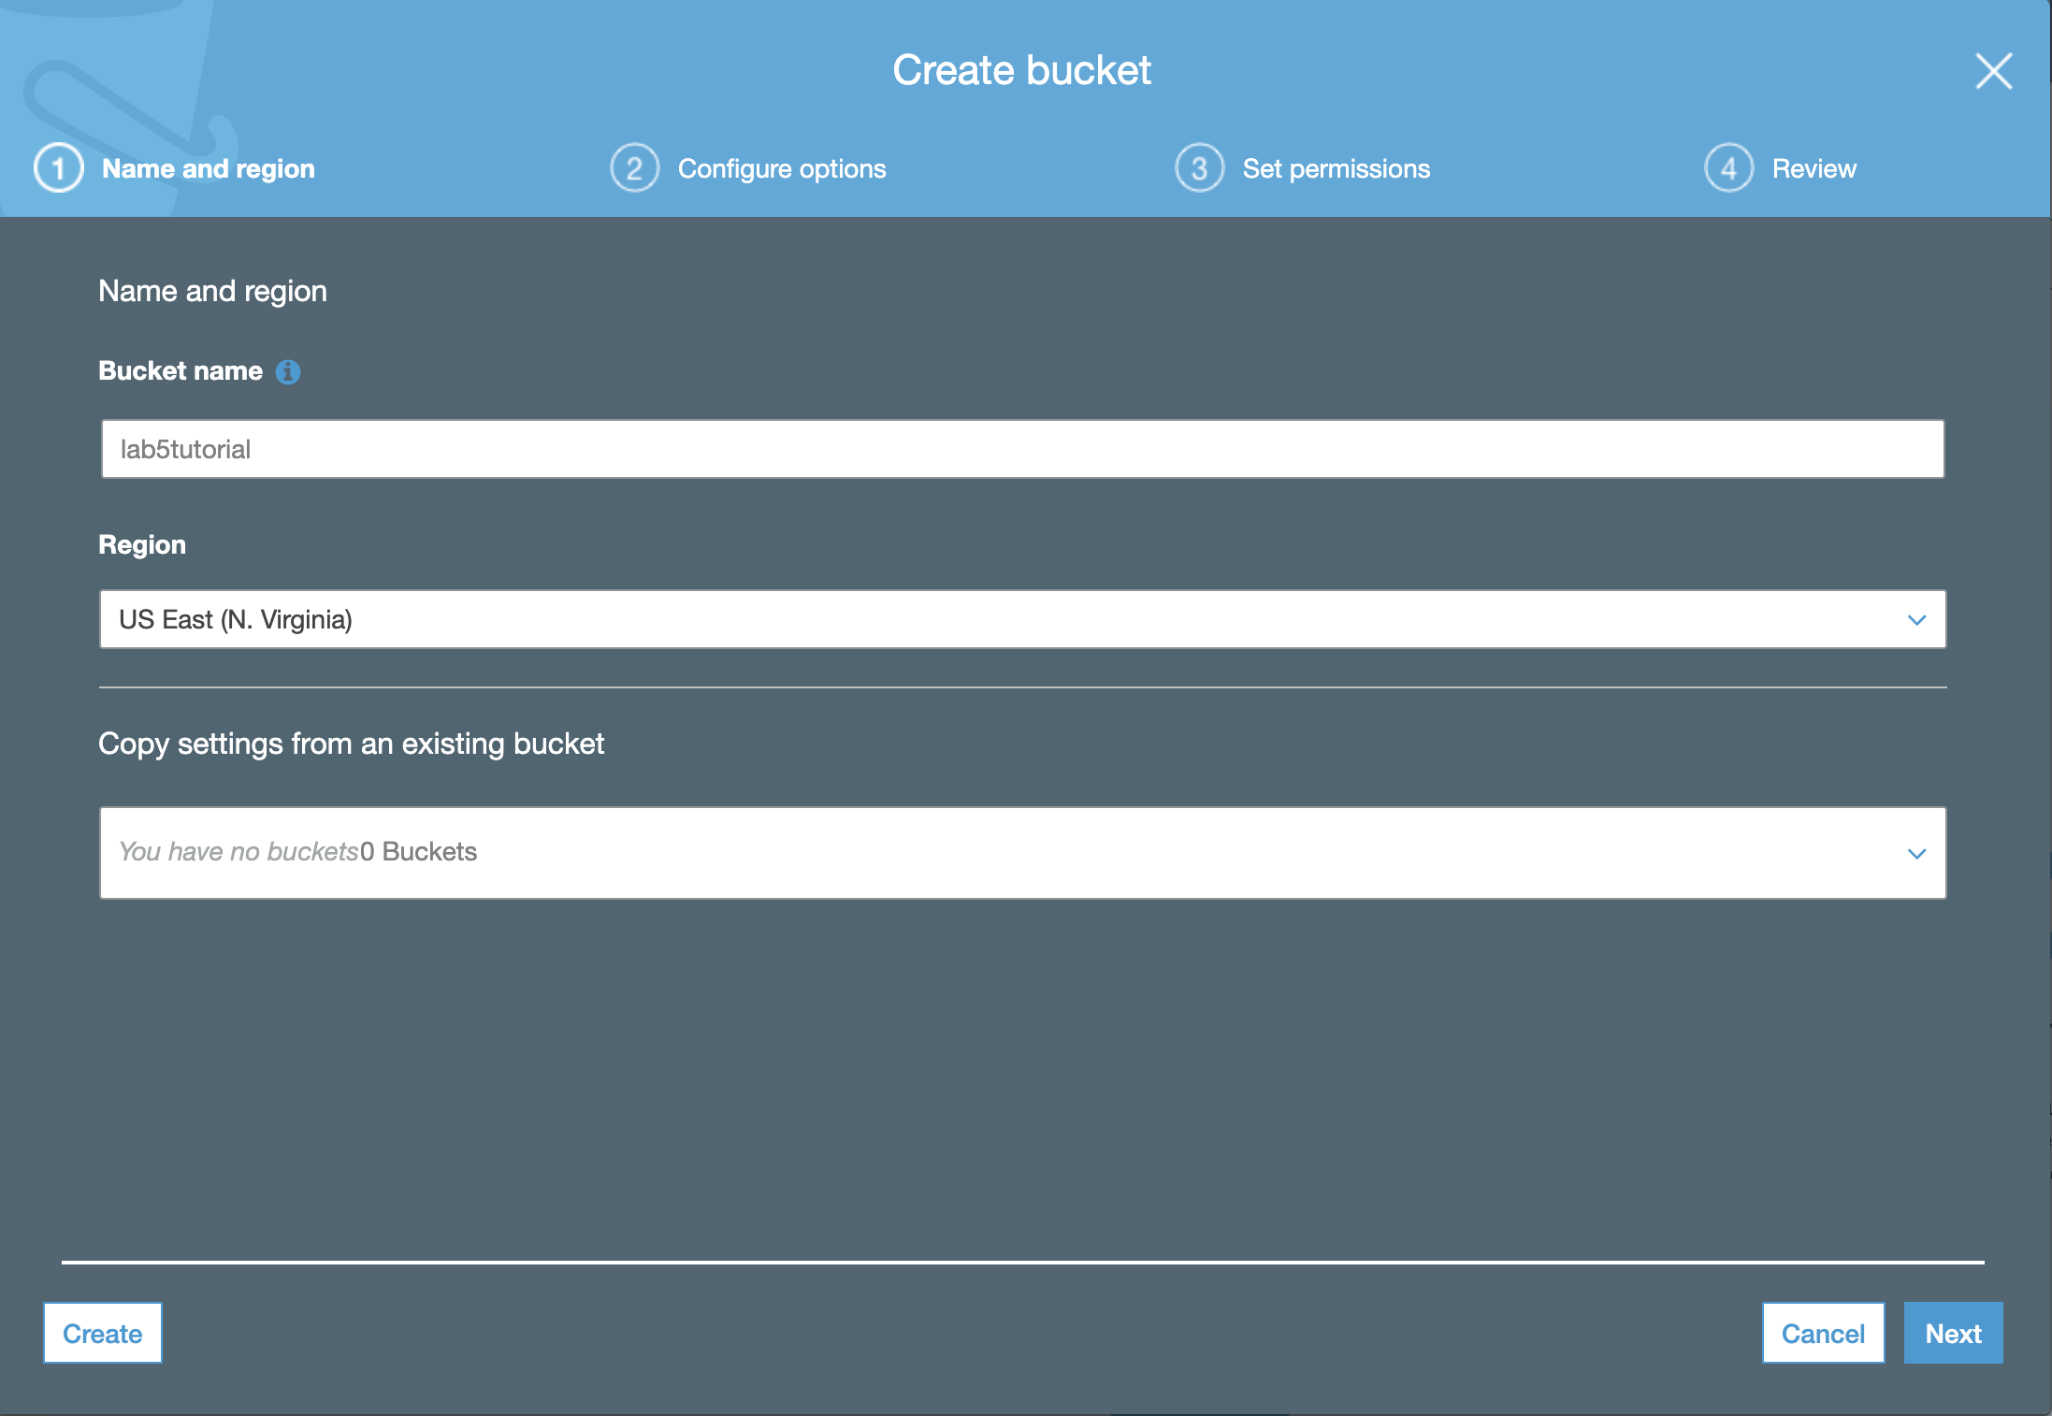
S3 and SNS
→ Create a bucket. We went with default settings and allowed public access to all.

Slide 10
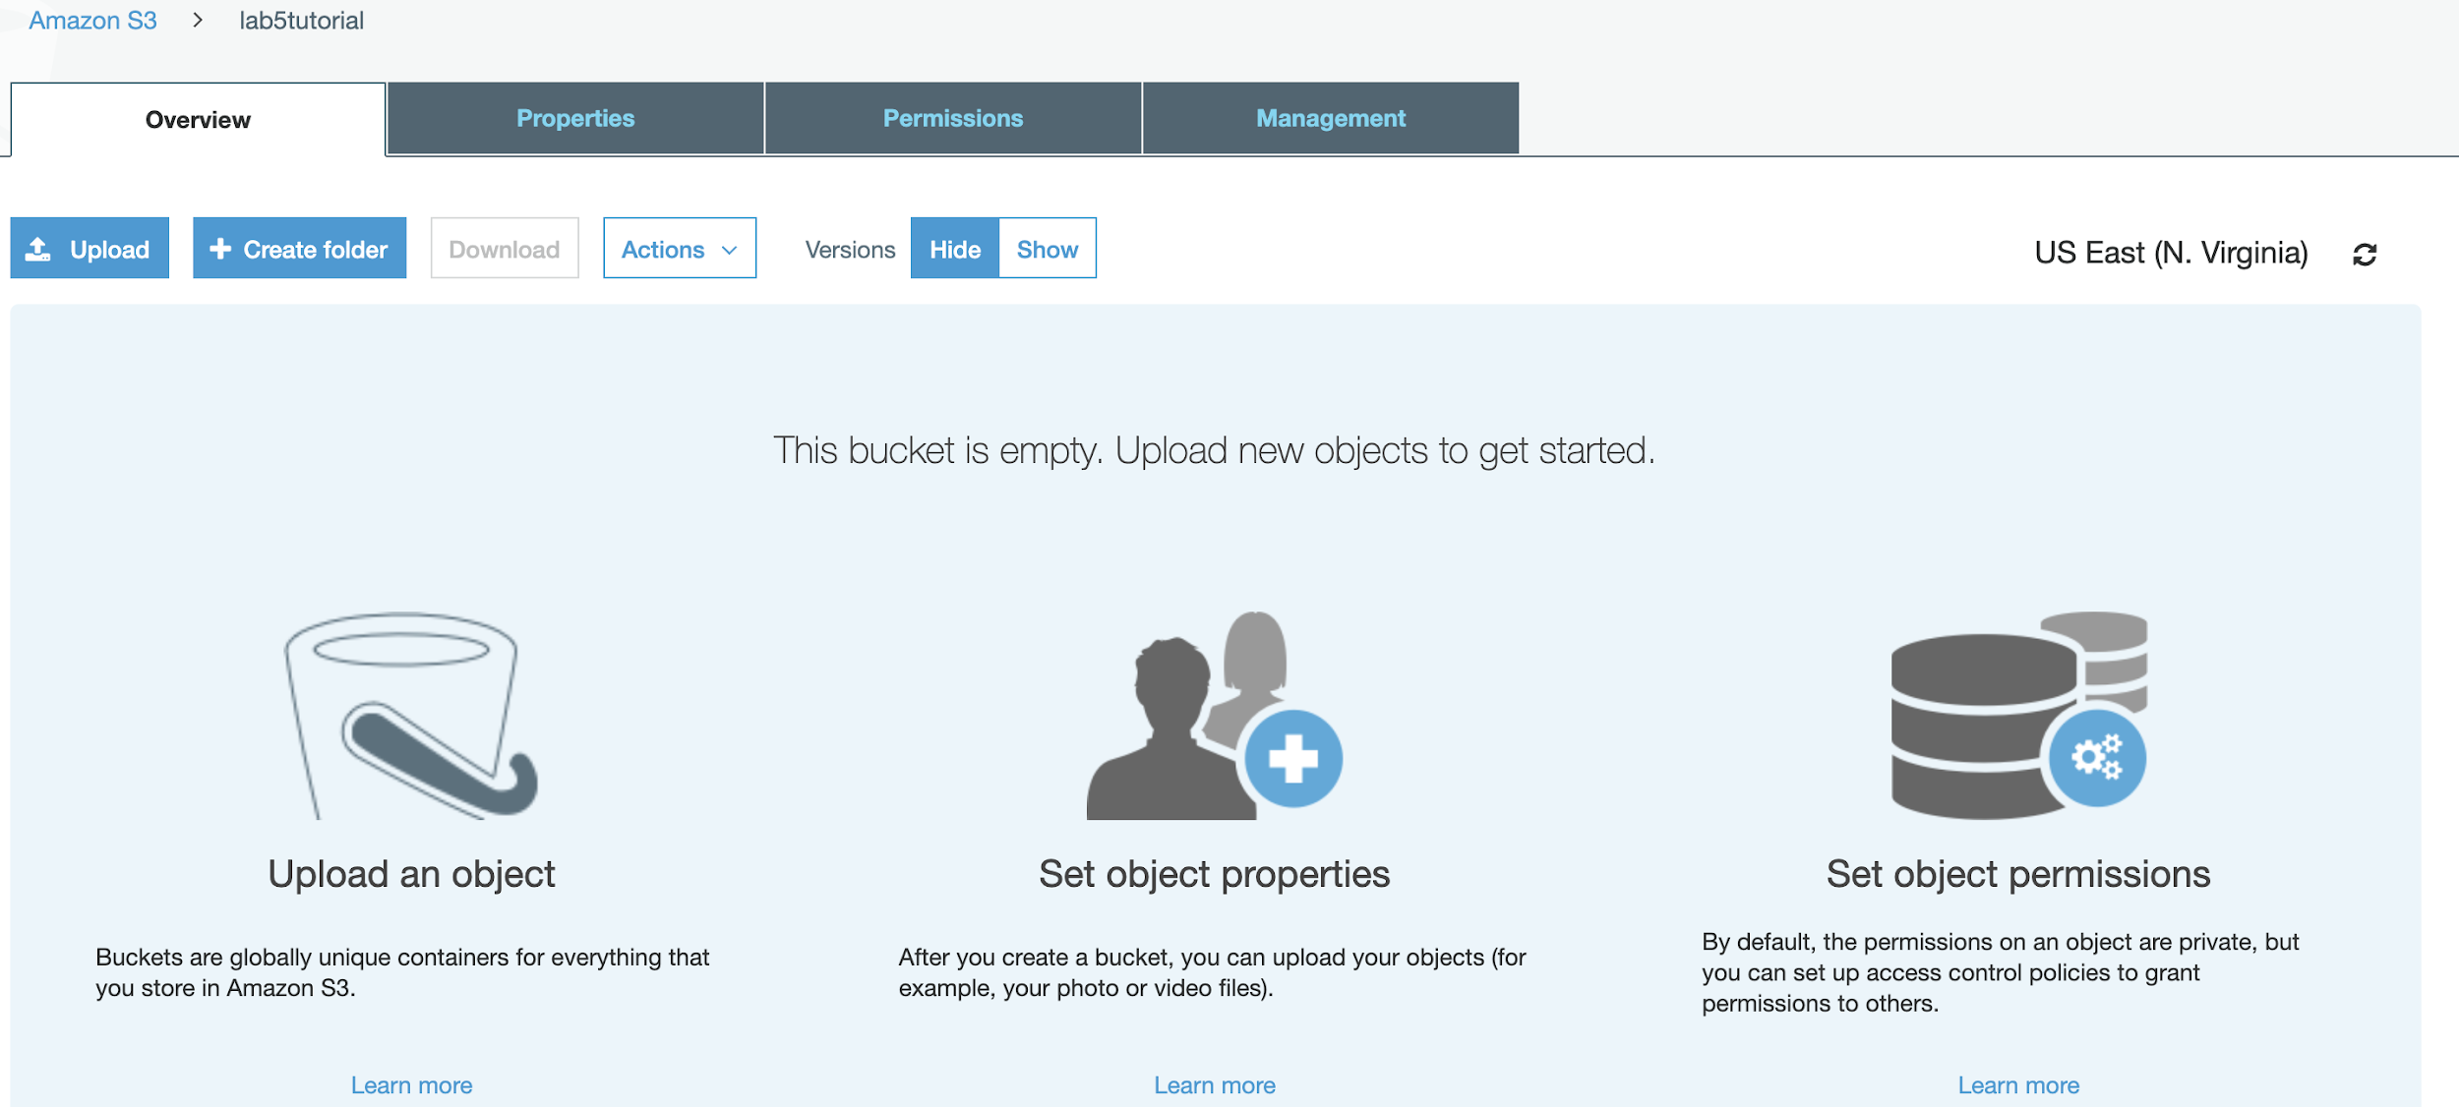
→ Now that the bucket has been created, we are ready to upload an image!
→ Click “Upload”

Slide 11
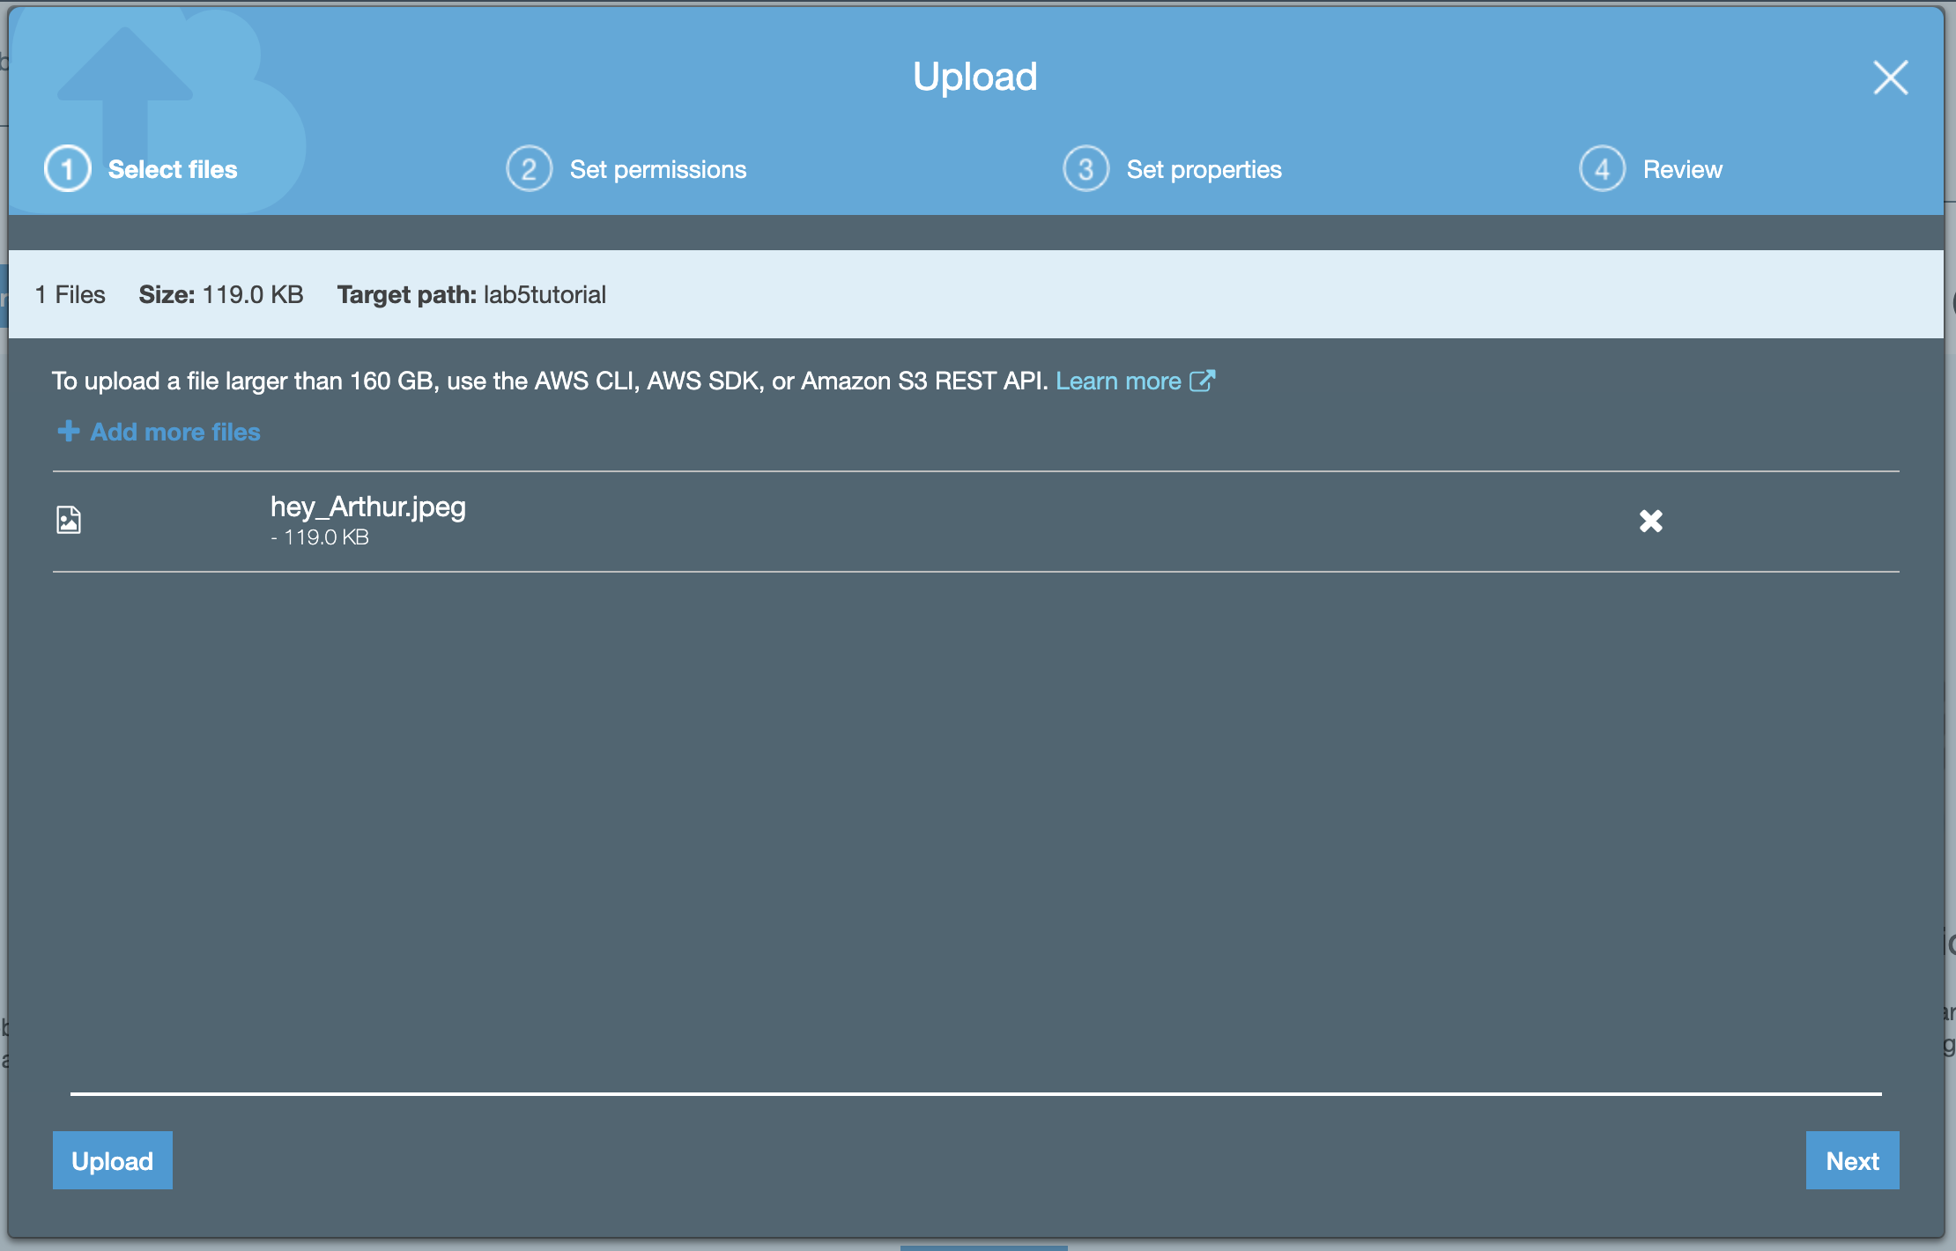
→ Uploading an image

Slide 12
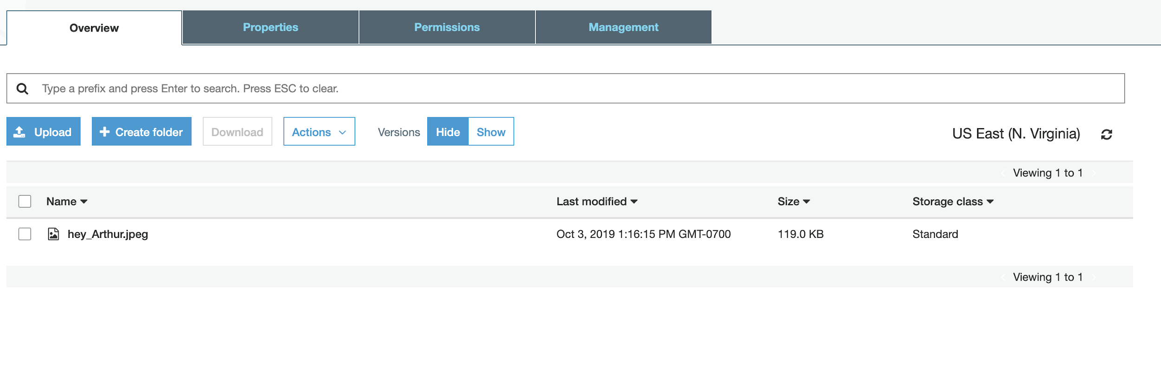
→ Uploading an image, image name is hey_arthur.jpeg

Slide 13
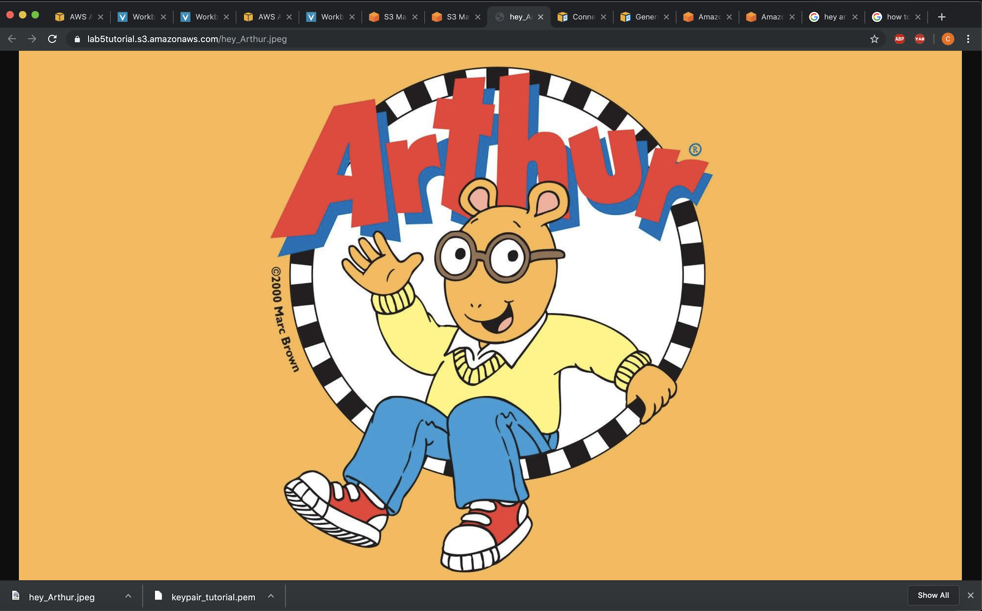
→ View of the image in the web browser.

Slide 14
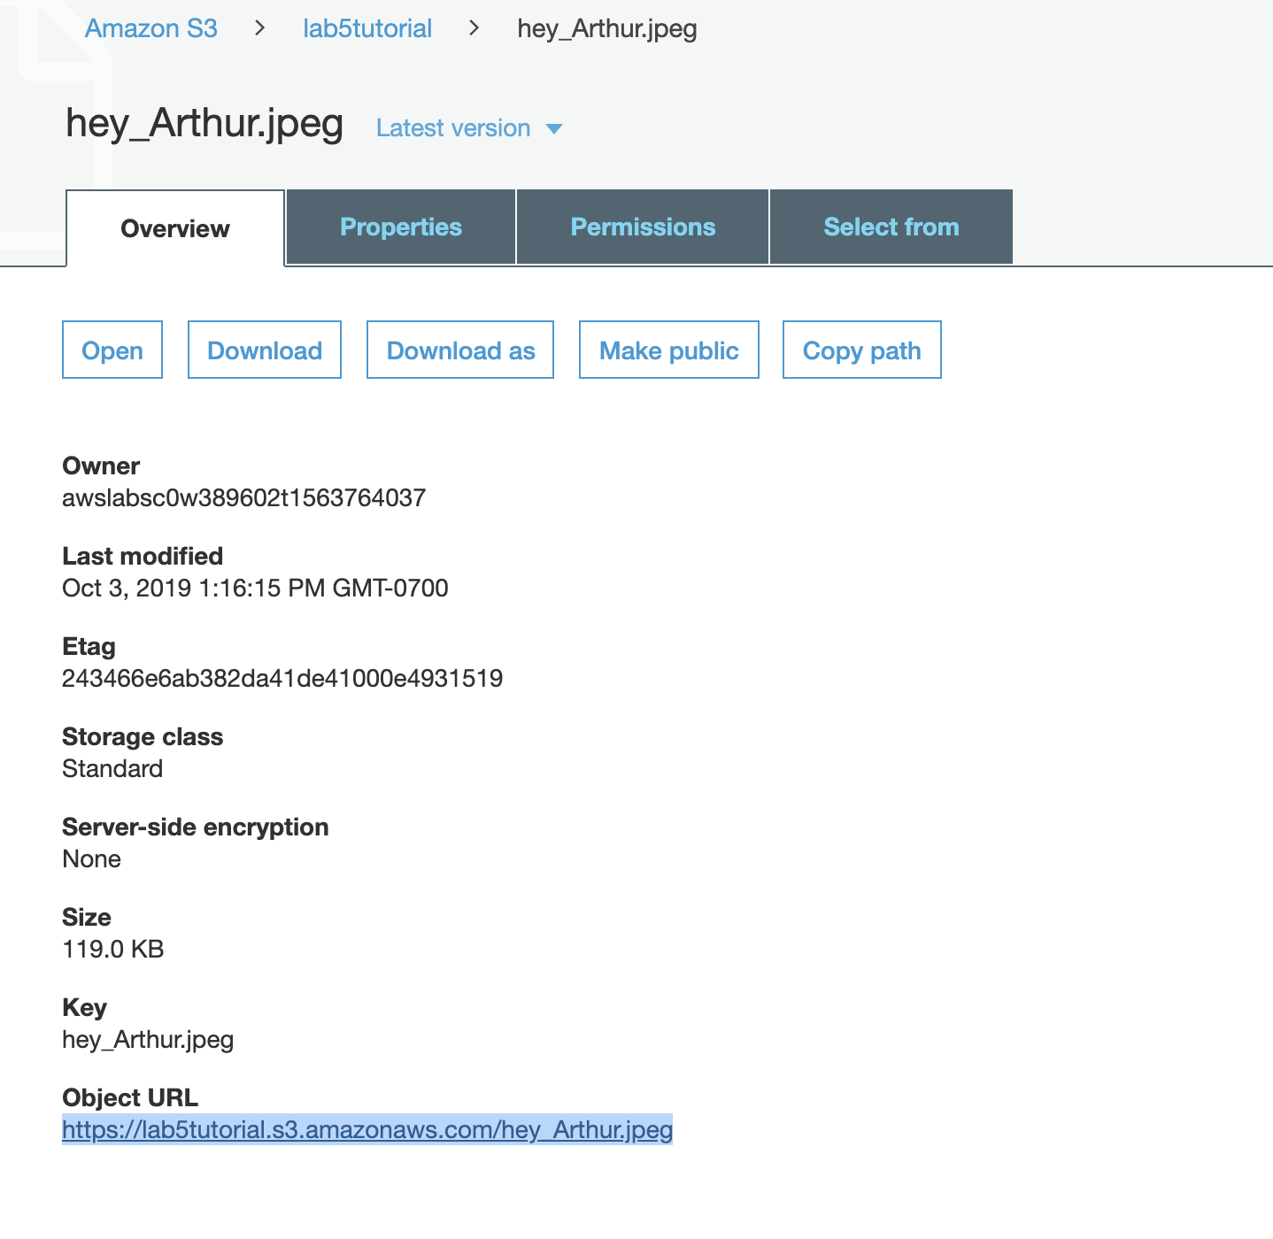
Image available at this URL
→ We deleted the bucket so you can no longer the view the image.. sorry.

Slide 15
Potential Uses for S3
→ This application is useful because if you were creating an app per say, you could have storage for particular users so that they’re information is private to anyone but them. And on the other hand, you could have an app in which files would be accessible by all users. This storage system allows applications to store all data on AWS.

Slide 16
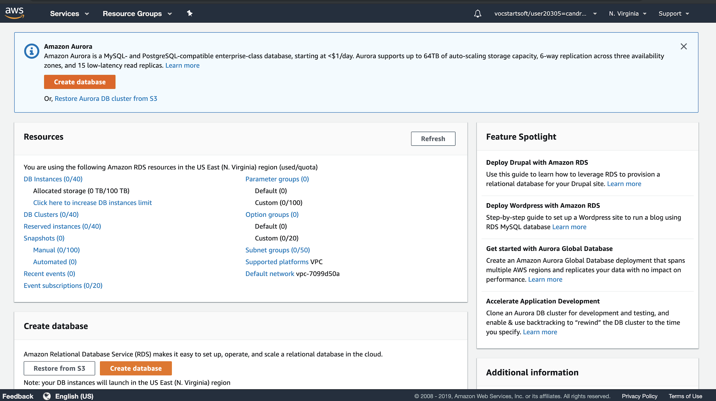
Amazon RDS

Slide 17
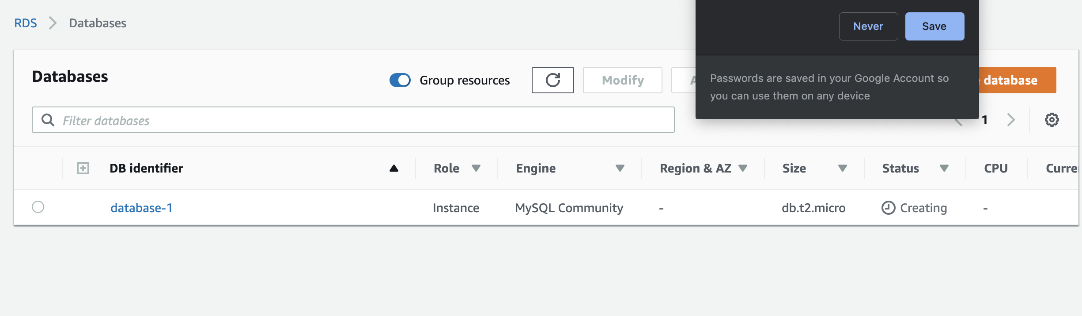
Here is the database

Slide 18
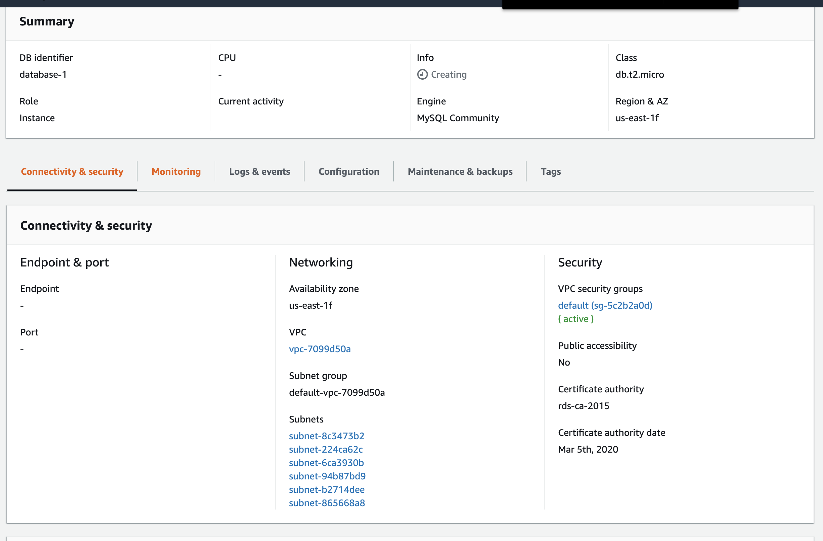
Creating the database

Slide 19
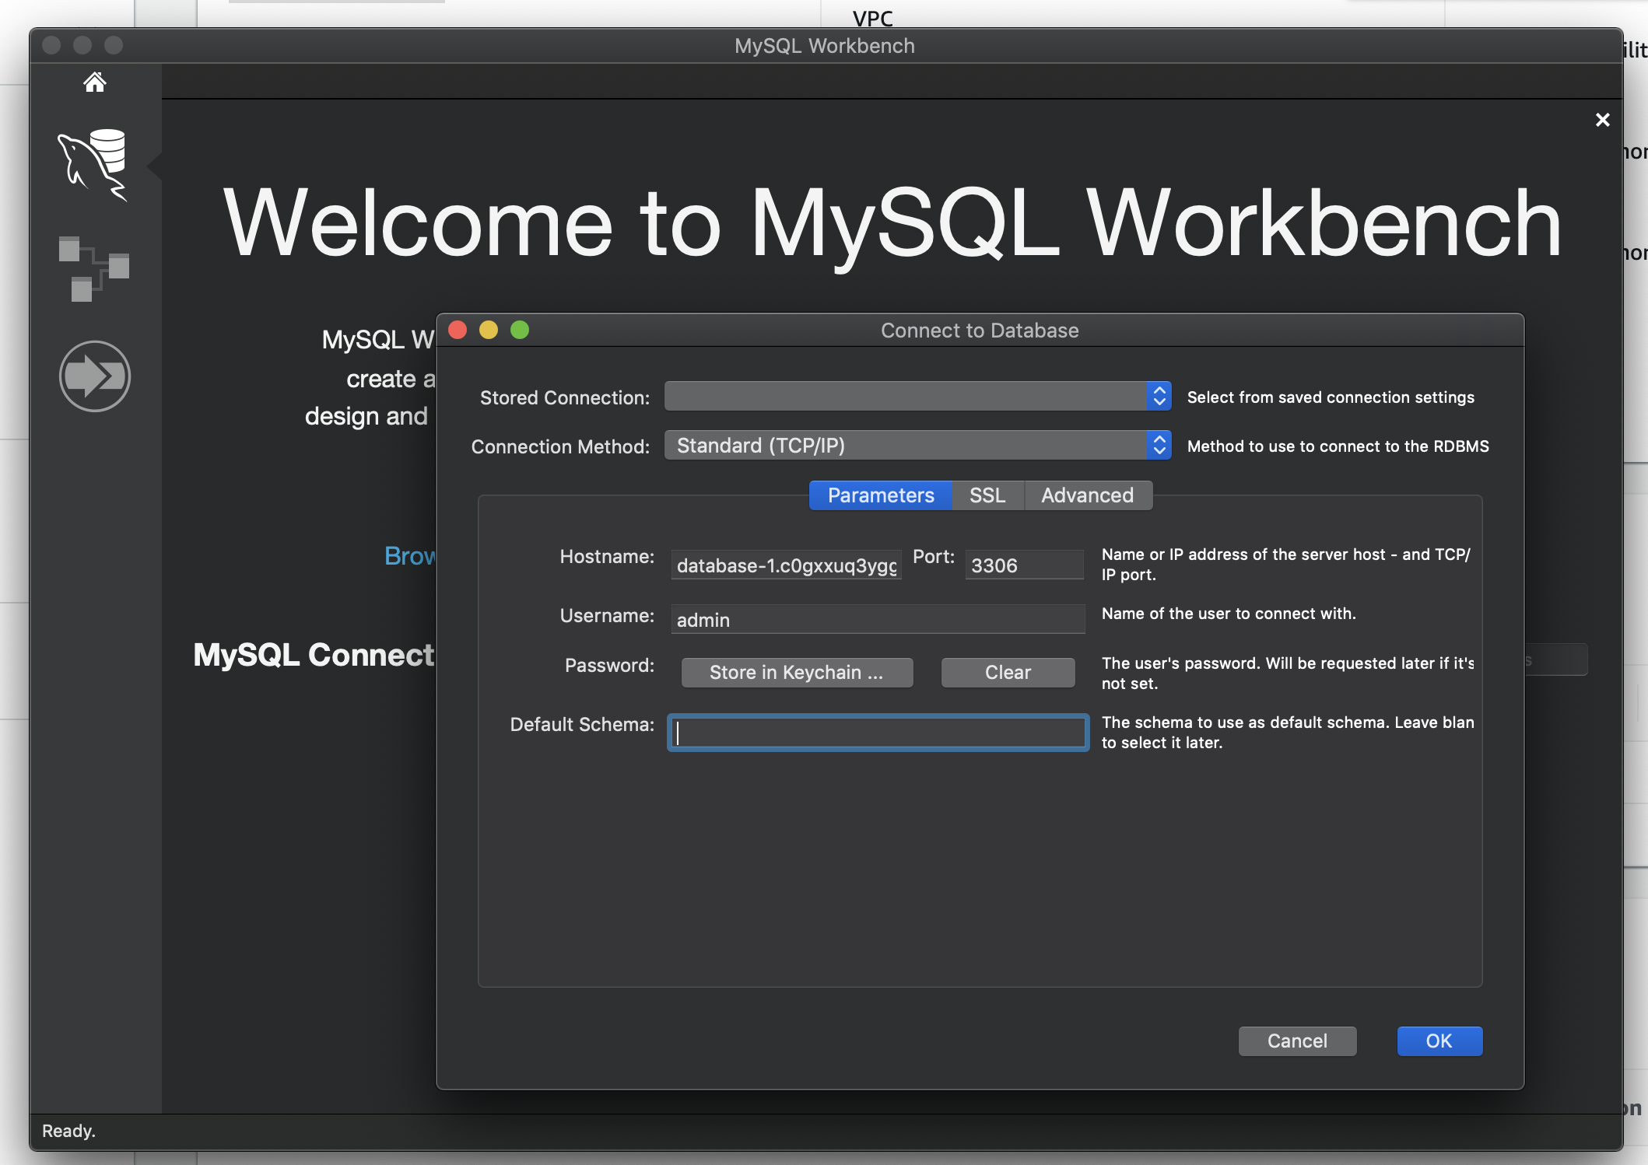
Connecting in the MySQLWorkbench App

Slide 20
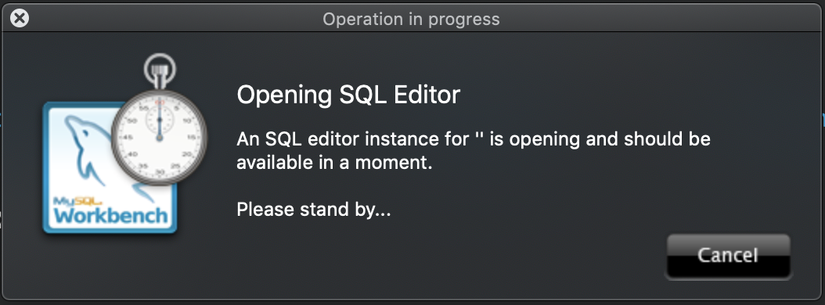
Opening the SQL editor

Slide 21
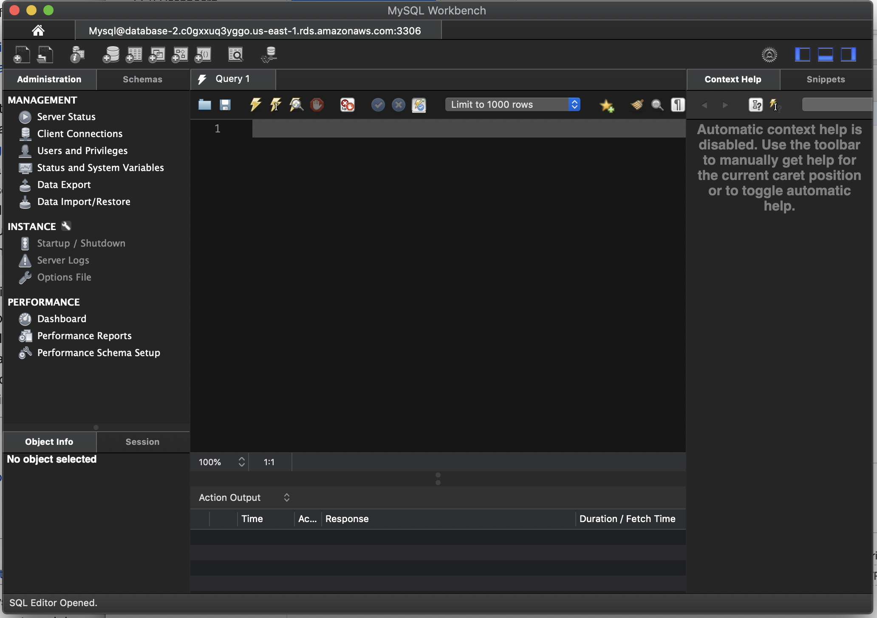
SQL editor is completely open

Slide 22
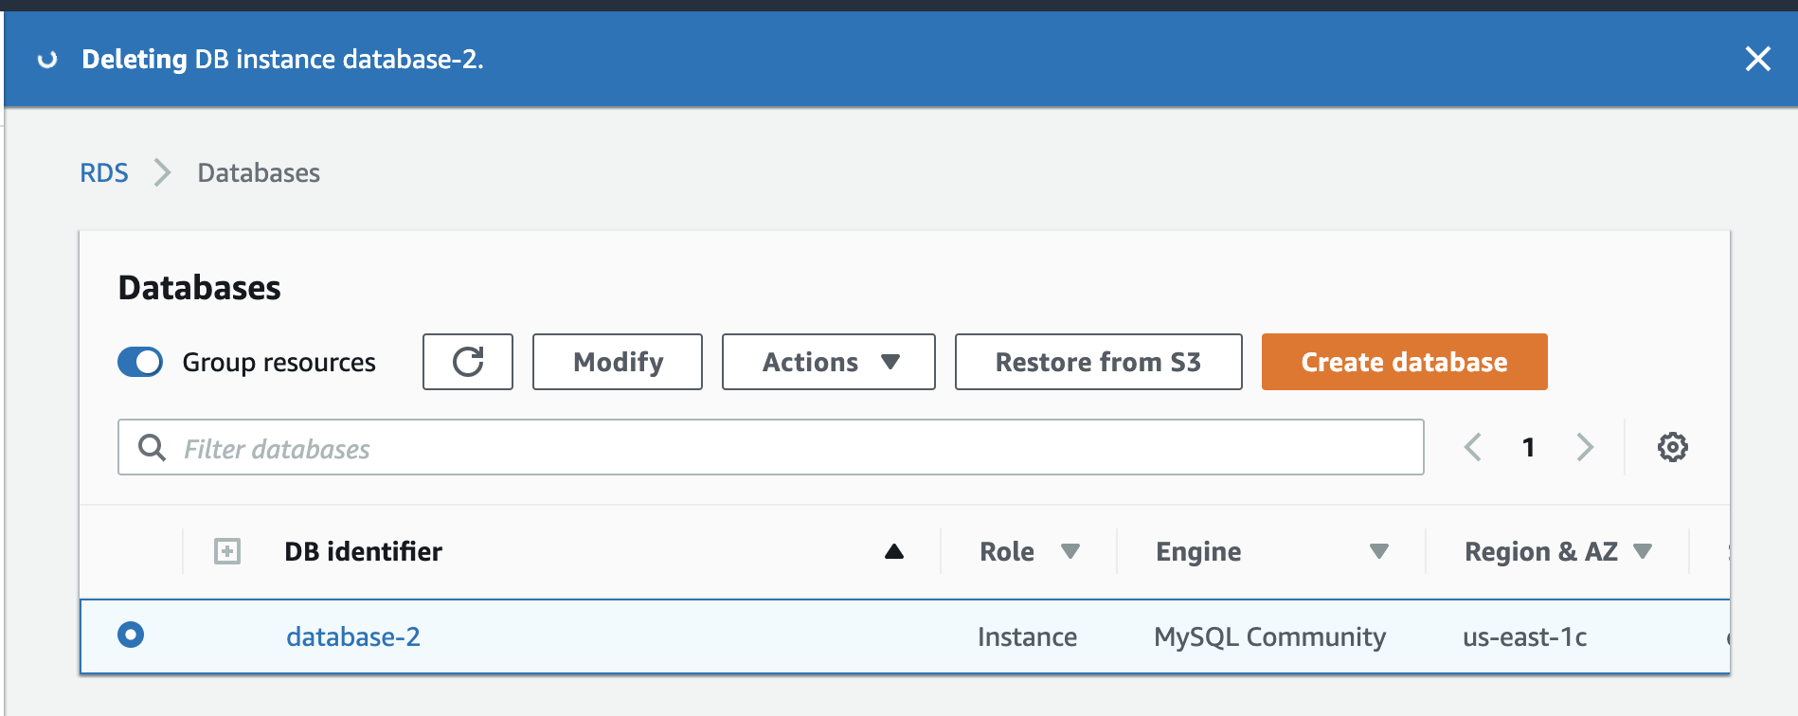
Make sure to delete this database

Slide 23
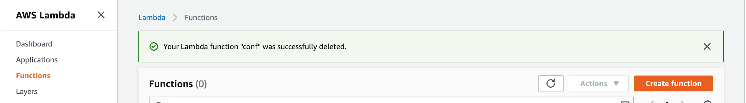
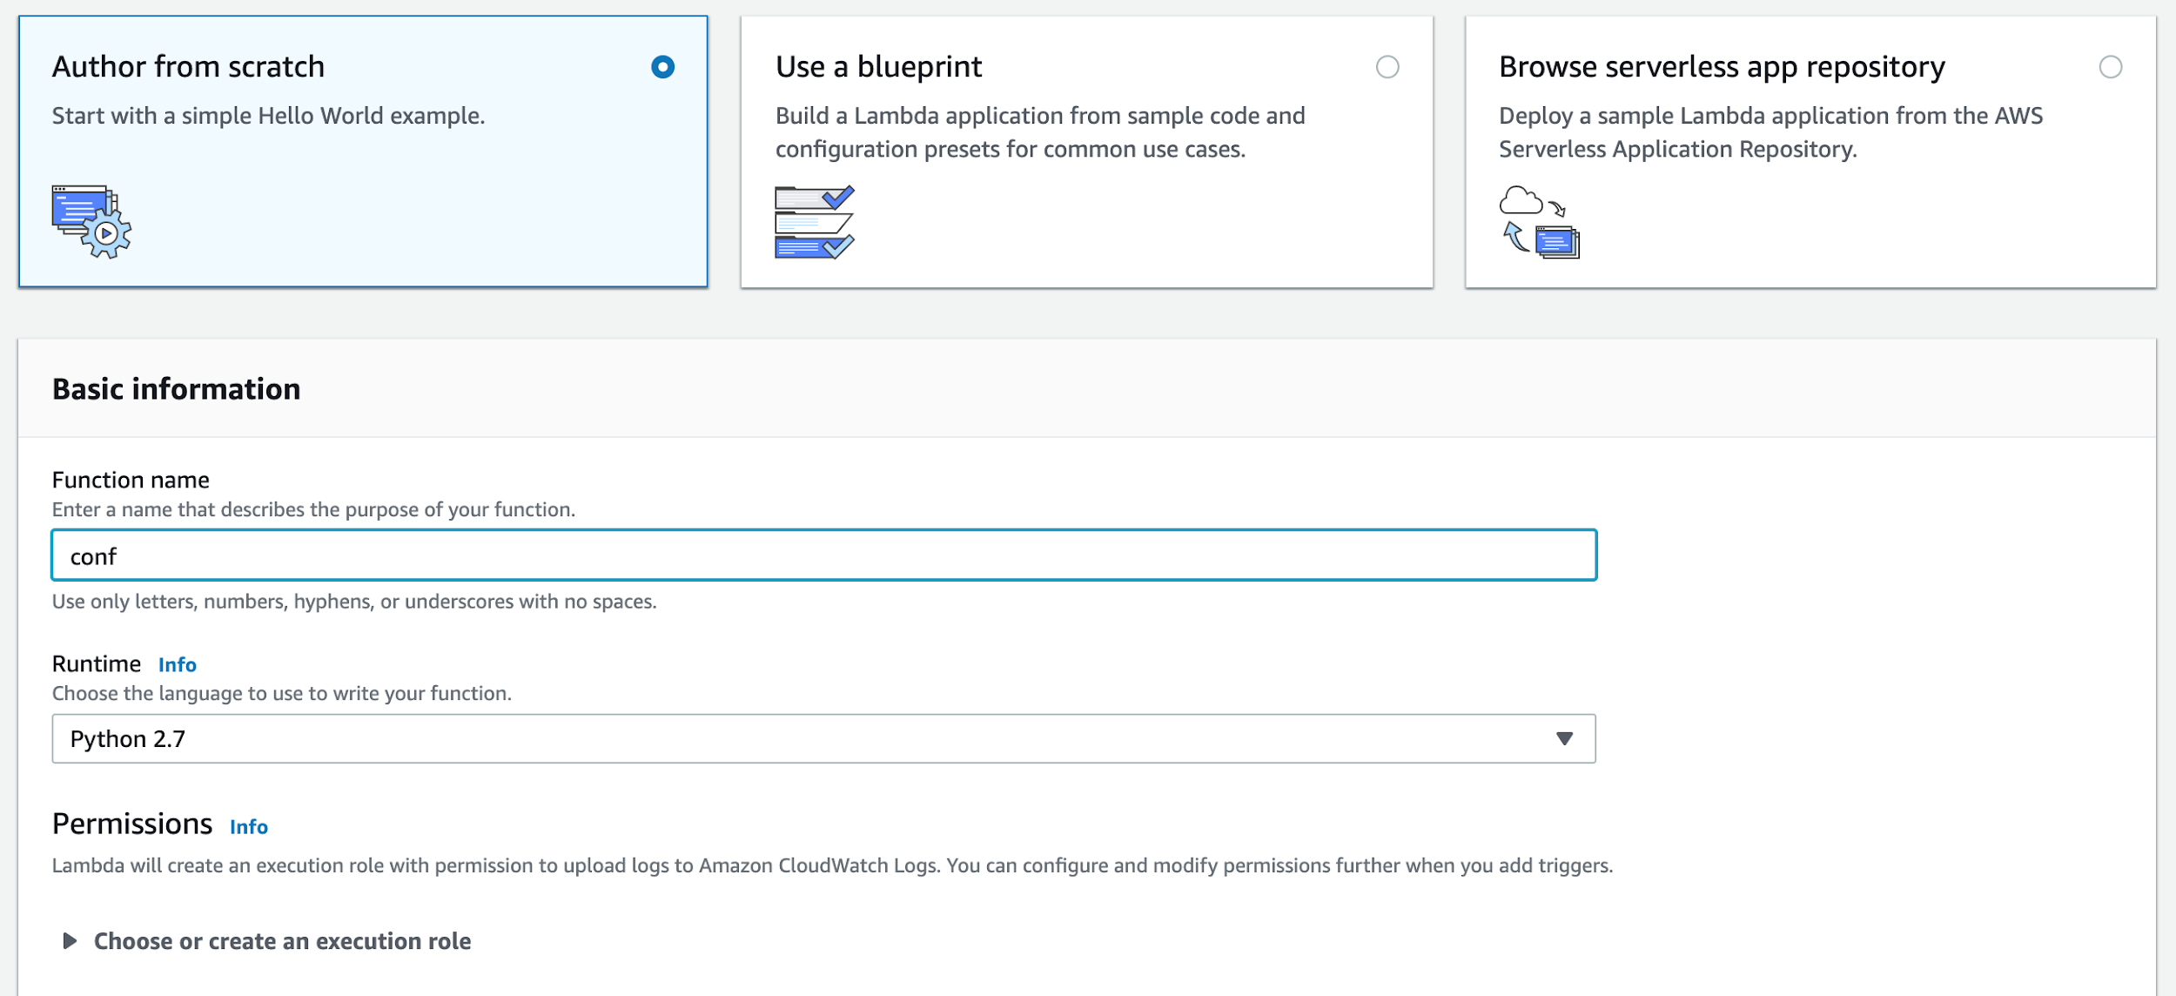
AWS Lambda
→ Create a new Lambda function by selecting “create function”
→ After creating the function, we chose to start from scratch as it was easier. Name your function something appropriate and choose your programming language. We chose Python because it’s just easier.

Slide 24
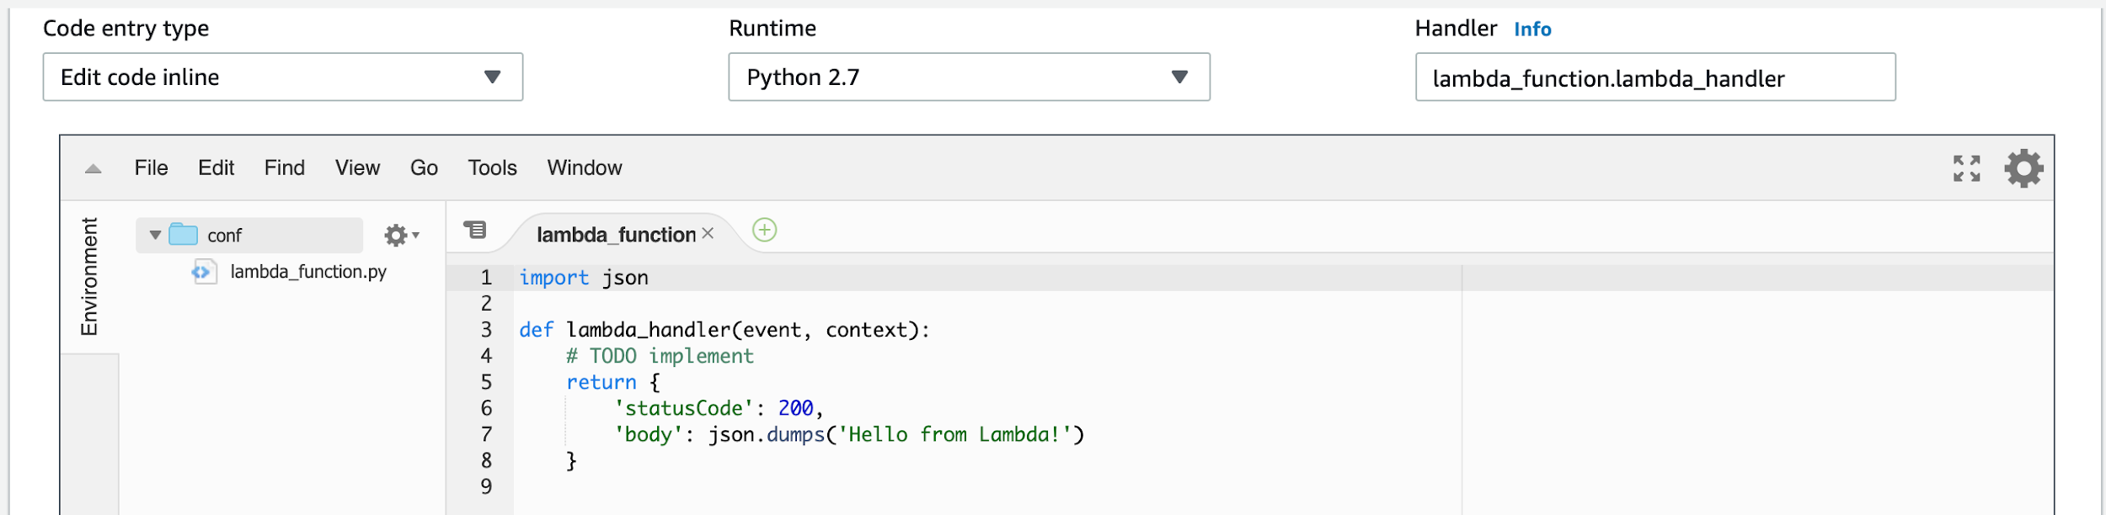
Lambda (cont…)
→ After creating your function, you are now ready to code. Scroll down and you will find an IDE with starter code.

Slide 25
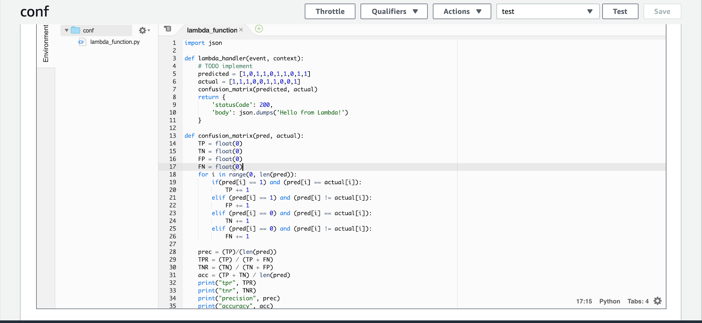
Lambda (cont…)
→ We were told to write code to model a confusion matrix given arrays for predicted and actual. Here is that code:

Slide 26
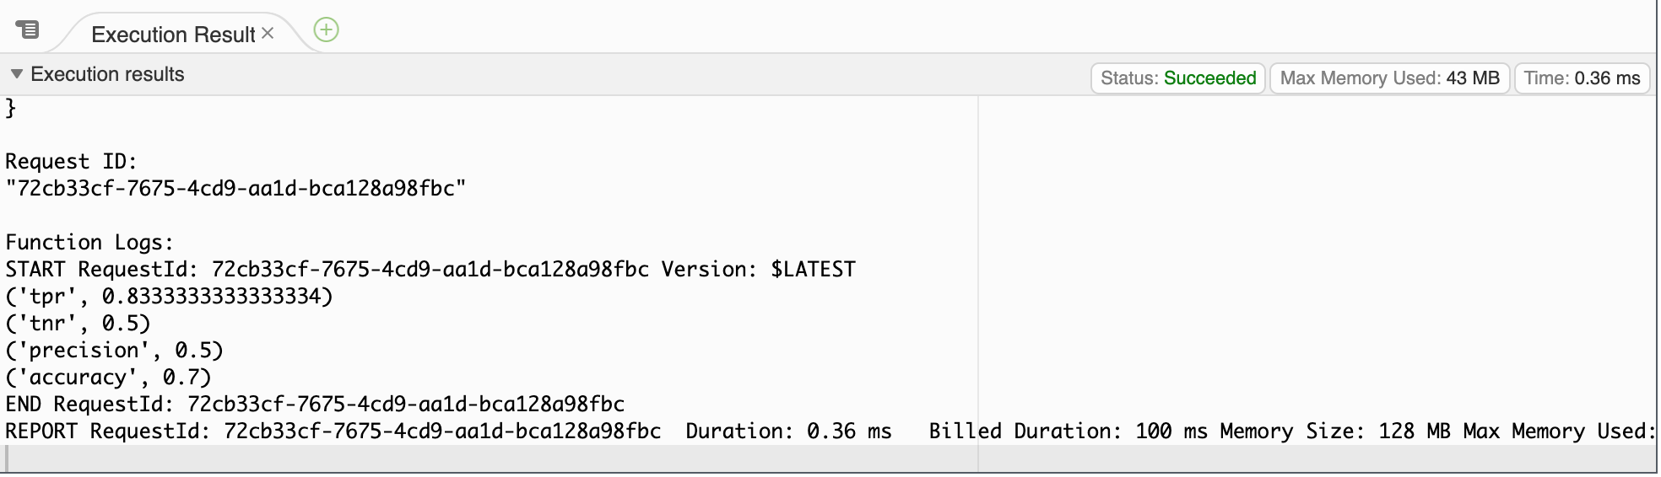
Lambda (cont…)
→ After writing the code, click on test on your upper right corner. Create a test event, we just used the basic hello world template. Now save and test your code. These are the results we got:

Slide 27
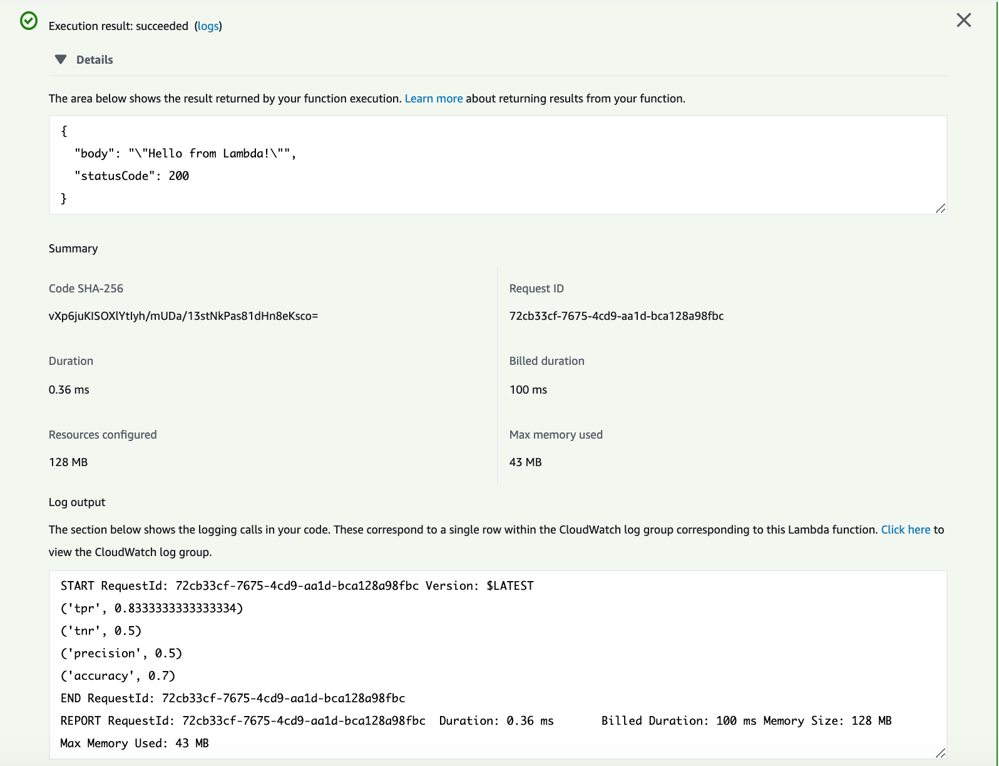
Lambda (cont…)
→ Summary Logs of Our Code Execution
→ Don’t forget to delete your function afterwards!!

Slide 28
→ fin.

